Slide 1
Computer Systems & Low-Level Programming
C: pointers, call-by-value, call-by-reference, bit manipulation
Marija Stanojevic
Spring 2019

Slide 2
Review (1)
Check comments you got for assignments
Next assignments: if code doesn’t run on server => 0 points for that work
return 0; vs exit(0);
return leaves function and exit leaves the program; exit is defined in <stdlib.h>
Division of two integers is integer
Cast one of the parameters to float in order to get float result (float)a/b; (float)5/2; => 2.5
(float) (a/b); would first calculate integer result and then turn it into float (float)(5/2); => 2.0
Printing % => printf(“Discount is 10%%”); would print: Discount is 10%
Printing “ => printf(“This is \”Temple\””); would print: This is “Temple”
scanf(“%s”, str); vs gets(str); vs fgets(str, 20, stdin);
scanf() and gets() allow don’t check size of input, so they are considered unsafe
use fgets(s, 20, stdin) instead; second parameter is max size of input, last parameter says where to read input from (stdin - standard input or file pointer)

Slide 3
Review (2)
Don’t specify format of printf in variable: printf(str); is wrong and insecure
If you call function before you define it, you need to declare it on top of the file
float avg(int n);
printf(“%.2f”, val); - prints float value with 2 decimal places
break - in loops and switch
if you are in switch and use break you would exit from switch, but not from loop around it
if you want to break from loop under some condition, use if/else for condition
Can’t condition on inequalities in switch in C
certain case is only one value, not a range of values; if you need ranges, use if/else
After last character in string there must be ‘\0’ to announce C that string ends
Make sure to have char array of size at least n+1 for string of length n
EOF character means that it’s end of file
if (c == EOF) printf(“File is read”);

Slide 4
Review (3)
Variable naming rules in C:
use letters (uppercase and lowercase), numbers and _
can’t start with number
#define WORD_WORD 100; is most commonly used syntax to define symbolic constants
int length1 or int length_1 or strLength or str_length are all often used in community
Choose one style and stick to it in the whole code
#define CON 100; vs const int con = 100;
first is symbolic constant and doesn’t occupy memory, instead every CON in code is substituted with 100. There is no datatype.
second is integer constant which is stored in memory as integer, but value can’t be changed
sizeof (int) - gives the amount of bytes reserved in memory for that type
fflush(stdin) - empty standard input

Slide 5
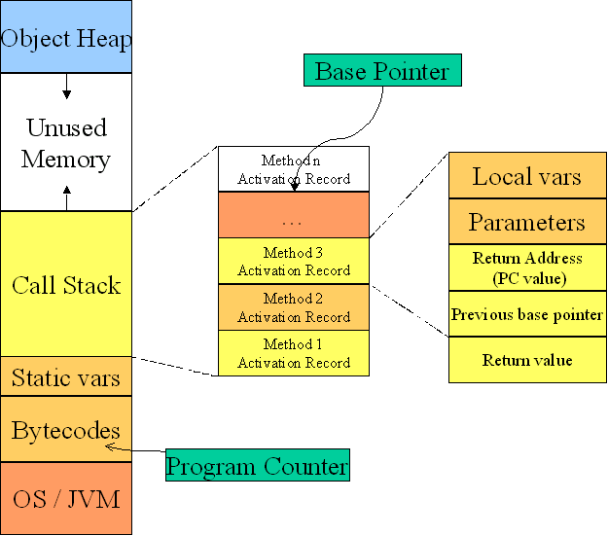

Slide 6
Pointers, by-value vs by-reference
To access the address of the variable use &
If you know the address and want to access data, use *
Addresses have 32-bits (=>old, up to 4GB RAM) or 64-bit (up to 16EB RAM)
When argument is passed by-value, its value is copied to function’s stack and all the changes happen on the copy. Once function ends its stack is deleted and program returned to the stack of the caller function. No change is visible, except if value was returned and saved into variable of caller function.
When argument is passed by-reference (address) all the value changes happen at that address, so they are visible after function ends
In C, pass by-value is default
To pass by-reference, you need to use & in front of the variable name

Slide 7
By-value vs by-reference example
# include <stdio.h>
int main() {
char name[50]; // name is an address of the first char in name
int age; // age is value, not address
int* ageP = malloc(sizeof(int)); // ageP is address which data is int
scanf(“%s”, name); // stores input starting from address name
scanf(“%d”, age); // memory fault error, storage address required
scanf(“%d”, &age); // stores input in the address of age value
scanf(“%d”, ageP); // stores input in the address ageP
printf(“%d”, age); // prints value of age
printf(“%d”, *ageP); // prints value of age stored in address ageP
printf(“%d”, ageP); // prints int version of address
printf(“%p”, ageP); // prints address of ageP in hexadecimal
return 0;
}

Slide 8
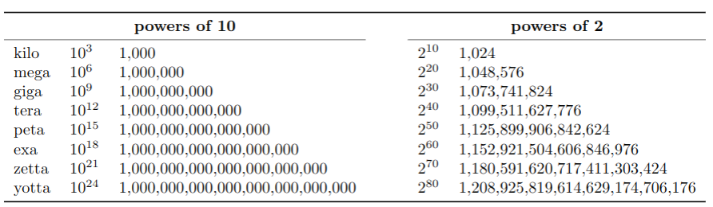
Bit Manipulation (1)
Decimal to binary: 140
Divide: 140/2 = 70; 70/2 = 35; 35/2 = 17; 17/2 = 8; 8/2 = 4; 4/2 = 2; 2/2 = 1; 1/2 = 0;
Modules: 140%2=0; 70%2=0; 35%2=1; 17%2=1; 8%2=0; 4%2=0; 2%2=0; 1%2=1;
Result (read modules from right to left): 1000 1100

Slide 9
Bit Manipulation (2)
Binary to decimal: 1000 1100
Multiply each digit by 2^{n}, where n is position from the right, sum:
1*2⁸ + 0*2⁷ + 0*2⁶ + 0*2⁵ + 1*2⁴ + 1*2³ + 0*2² + 0*2¹
Binary addition: do right alignment of numbers and add digits in same position.
Sum numbers from right to left. Append smaller number with 0 on the left.
If sum is 2 write 0 and add one to the position on the left.
Example: 1000 1100 (decimal 140)
+ 0001 1001 (decimal 25)
Result: 1010 0101 (decimal 165)
Bitwise Negation: ~1000 1100 => 0111 0011 (decimal 115), 0 goes to 1 and 1 to 0
Bitwise AND: do right alignment of numbers. Append smaller with 0 on the left.
Rules: 0 & 0 => 0; 0 & 1 => 0; 1 & 0 => 0; 1 & 1 => 1
Example: 1000 1100 (decimal 140)
& 0001 1001 (decimal 25)
Result: 0000 1000 (decimal 8, always <= than both operands)

Slide 10
Bit Manipulation (2)
Bitwise OR: do right alignment of numbers. Append smaller with 0 on the left.
Rules: 0 | 0 => 0; 0 | 1 => 1; 1 | 0 => 1; 1 | 1 => 1
Example: 1000 1100 (decimal 140)
& 0001 1001 (decimal 25)
Result: 1001 1101 (decimal 157, always >= than both operands)
Bitwise XOR: do right alignment of numbers. Append smaller with 0 on the left.
Rules: 0 ^ 0 => 0; 0 ^ 1 => 1; 1 ^ 0 => 1; 1 ^ 1 => 0
Example: 1000 1100 (decimal 140)
& 0001 1001 (decimal 25)
Result: 1001 0101 (decimal 149)
What is the difference?: ! vs ~; && vs &; || vs |
Yellow operand is logical operator on the level of whole number
Orange operand is bitwise operator and compares bit-by-bit in number

Slide 11
Bit Manipulation (3)
Shift right >>: shifts all bits to the right X times and X rightmost bits are deleted. Same as division by 2^{X}.
1000 1100 >> 2; gives 1000 11 which is decimal 35, (ie. 140 / 2² = 35)
Shift left <<: shifts all bits to the left X times and zeros are added to the X rightmost bits. Same as multiplication by 2^{X}.
1000 1100 << 3; gives 100 0110 0000, decimal 1120 (ie. 140*2³=1120)
Binary to octal:
1000 1100 = 10 001 100 => 10 becomes 1 * 2¹ + 0 * 2⁰, ie. 2. 001 becomes 0 * 2² + 0 * 2¹ + 1 * 2⁰, ie. 1. 100 becomes 1 * 2² + 0 * 2¹ + 0 * 2⁰, ie. 4. So, 214.
Hexadecimal to octal:
1000 1100 => 1000 becomes 1 * 2³ + 0 * 2²+ 0 * 2¹ + 0 * 2⁰, ie. 8. 1100 becomes 1 * 2³ + 1 * 2² + 0 * 2¹ + 0 * 2⁰, ie. C. So, hexadecimal number is 8C.
Octal to binary: same as decimal to binary, but divide and take moduo with 8
Hexadecimal to binary: same as above, but divide and take moduo with 16

Slide 12
Bit Manipulation (4)
Two’s complement of X is ~X + 1:
~1000 1100 + 1 = 0111 0011 + 1 = 0111 0100
Binary subtraction:
Example: 1000 1100 (decimal 140)
- 0001 1001 (decimal 25)
Result: 0111 0011 (decimal 115)
Negative number is two’s complement of its positive value (starts with 1):
25 is 0001 1001 => -25 is ~0001 1001 + 1 = 1110 0110 + 1 = 1110 0111
Float numbers to binary float numbers:
0.125 * 2 = 0.25, 0.25 * 2 = 0.5, 0.5 * 2 = 1.0 => 0.001
0.675*2=1.35, 0.35*2=0.7, 0.7*2=1.4, 0.4*2=0.8, 0.8*2=1.6,...=> 0.10101
INT_MIN and INT_MAX is the range of integers that can be stored.
What happens when we do INT_MAX + 5? We get INT_MIN + 4
What happens when we do INT_MIN - 10? We get INT_MAX - 9

Slide 13
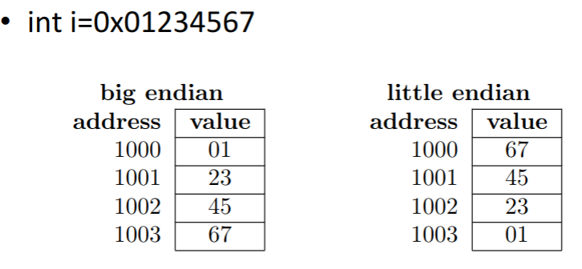
Byte ordering
Big endian: most significant byte first: as we are used to write numbers
Little endian: least significant byte first: used in most computers to make bitwise operations easier

Slide 14
Operations with pointers
Addition: pointer + integer increments value of pointer: int i, *p; p = p+i;
Subtraction: pointer - pointer results in integer which says how distant two pointers are (eg. find position of element in array): int i, *p, *q; i = p - q;
No other operations are possible
Bitwise operations code examples
Lab 4 code: check if palindrome
Presentation: Lab 5 for section 005, Lab 6 for section 001

